Slide 1
Introduction to
Database Design

Slide 2
Agenda
Definition of Database System
Database Normalization
Normalization Rankings
Types of Normalization
Case Study
Where to go from here
Questions

Slide 3
Database Normalization
It is the process of efficiently organizing data in a database. There are two goals of the normalization process: eliminate redundant data (for example, storing the same data in more than one table) and ensure data dependencies make sense (only storing related data in a table).
Both of these are worthy goals as they reduce the amount of space a database consumes and ensure that data is logically stored.

Slide 4
Normalization Rankings
The database community has developed a series of guidelines for ensuring normalization. These are referred to as normal forms and are numbered from one (first normal form or 1NF) through five (fifth normal form or 5NF).

Slide 5
Normalization
Type
Definitions

Slide 6
1st Normal Form
First normal form (1NF) sets the very basic rules for an organized database and is the lowest form of normalization

Slide 7
1st NF Guidelines
Eliminate duplicative columns from the same table.
Create separate tables for each group of related data
Identify each row with a unique column or set of columns (the primary key).

Slide 8
Primary Key
Uniquely identifies each record in a table. It can either be a normal attribute that is guaranteed to be unique or it can be generated by the DBMS. It may consist of a single attribute or multiple attributes in combination.

Slide 9
2nd Normal Form
Second normal form (2NF) further addresses the concept of removing duplicative data

Slide 10
2nd NF Guidelines
Meet all the requirements of the 1NF
Remove subsets of data that apply to multiple rows of a table and place them in separate tables.
Create relationships between these new tables and their predecessors through the use of foreign keys.

Slide 11
Foreign Key
A foreign key is a relationship or link between two tables which ensures that the data stored in a database is consistent.
The foreign key link is set up by matching columns in one table (the child) to the primary key columns in another table (the parent).

Slide 12
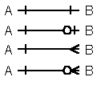
Relationship Symbols

Slide 13
3rd Normal Form
Third normal form (3NF) goes one large step further

Slide 14
3rd NF GuideLines
Meet all the requirements of the 2NF.
Remove columns that are not dependent upon the primary key

Slide 15
4th Normal Form
Finally, fourth normal form (4NF) has one additional requirement.

Slide 16
4th NF GuideLines
Meet all the requirements of the 3NF.
A relation is in 4NF if it has no multi-valued dependencies.

Slide 17
GuideLines Not Rules
It is important to point out that these are guidelines only. Occasionally, it becomes necessary to stray from them to meet business requirements.

Slide 18
GuideLines Not Rules contd.
When variations take place, it's extremely important to evaluate any possible problems they could have on your system and account for possible inconsistencies.

Slide 19
Case Study

Slide 20
User Story
We need to be create an address book. The system has to have the ability to contain multiple addresses, phone, web contact information.

Slide 21
Example
Name: Joe Smith
Addresses:
House: 1234 Some St., West Jordan, UT, 84088
Work: 5555 Where St. Salt Lake City, UT, 99999
Mailing: PO Box 333, West Jordan, UT 84088

Slide 22
Example cont’d
Phone:
Work: 801-123-5555
Cell: 801-124-5555
Home: 801-152-5555
Pager: 801-222-5555
Fax: 800-555-1212
Web:
Work: JSmith@Bob.com
Personal: JS@yahoo.com
FTP: ftp:\\joebob.com
ICQ: 1234456
MSN: js@msn.com

Slide 23
Start
Designing

Slide 24
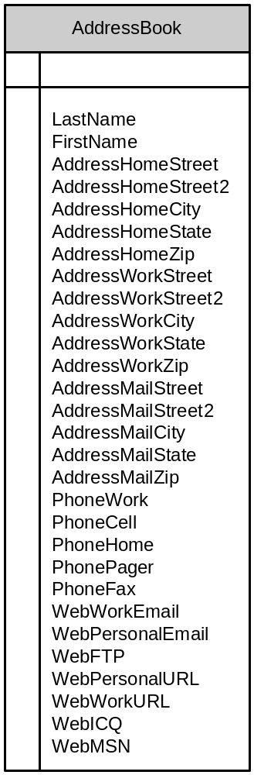
Initial Data Structure

Slide 25
Migrate from Initial to 1NF
Check to see if there are duplicate columns
Create separate tables for each different group
Create a primary key for each group

Slide 26
#1: Check Duplicate Columns
None
Found

Slide 27
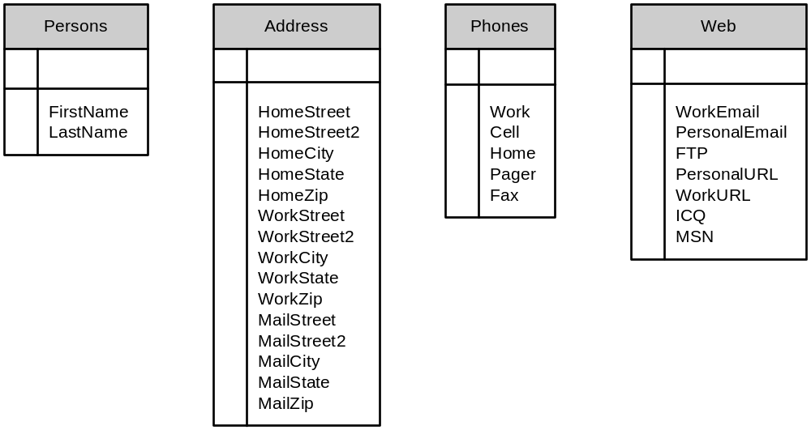
#2: Create Separate Tables

Slide 28
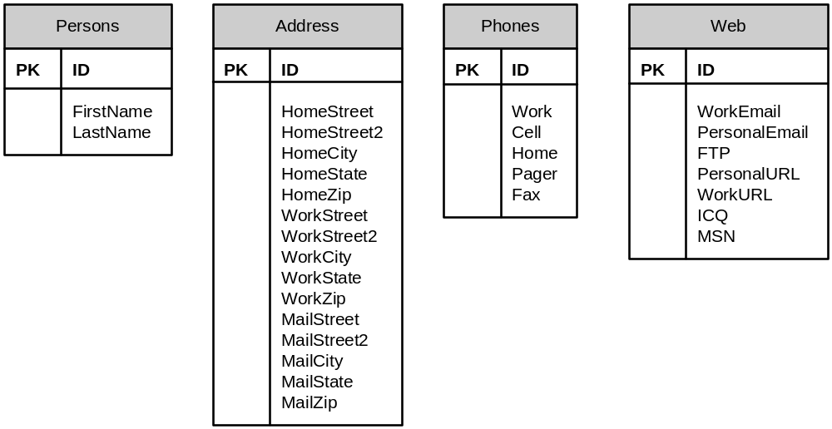
#3: Primary Key

Slide 29
Migrate from 1NF to 2NF
Remove subsets of data that apply to multiple rows of a table and place them in separate tables.
Create relationships between these new tables and their predecessors through the use of foreign keys.

Slide 30
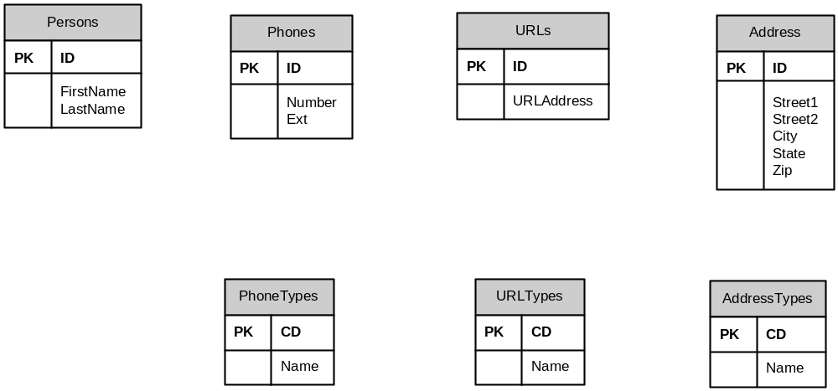
#1: Remove Subsets of Data

Slide 31
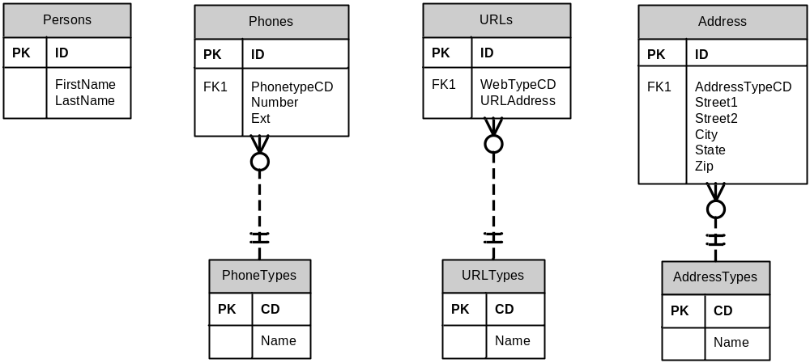
#2: Create Relationships

Slide 32
Migrate from 2NF to 3NF
Remove columns that are not dependent upon the primary key

Slide 33
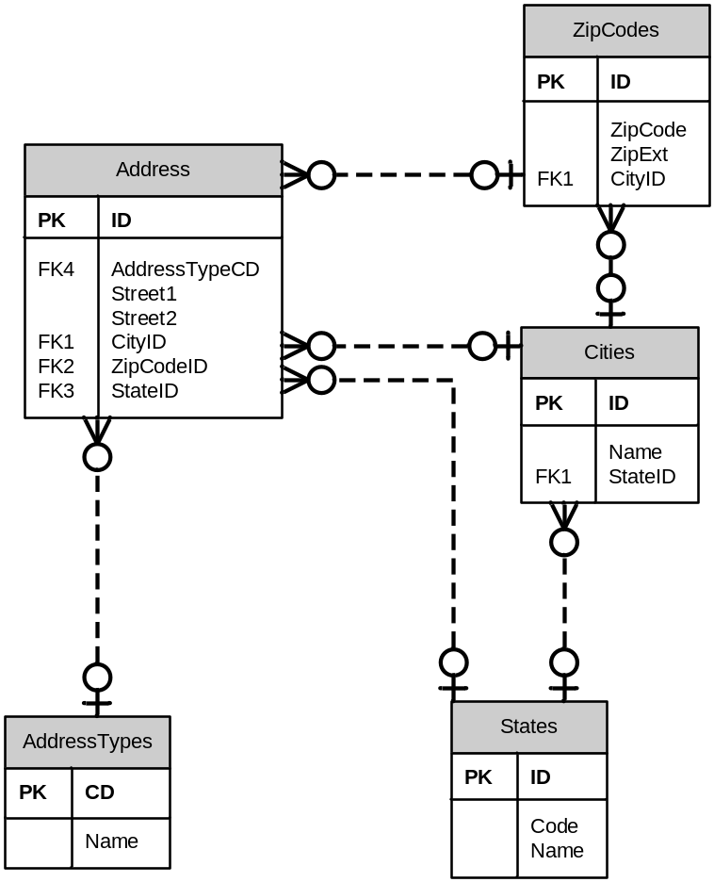
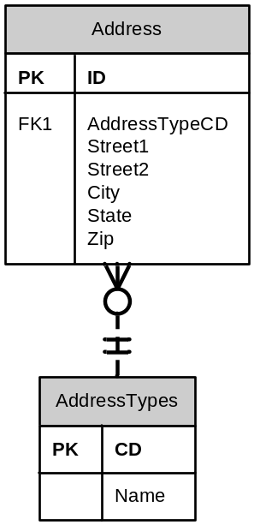
#1: Put Non-Dependent data in Different Table

Slide 34
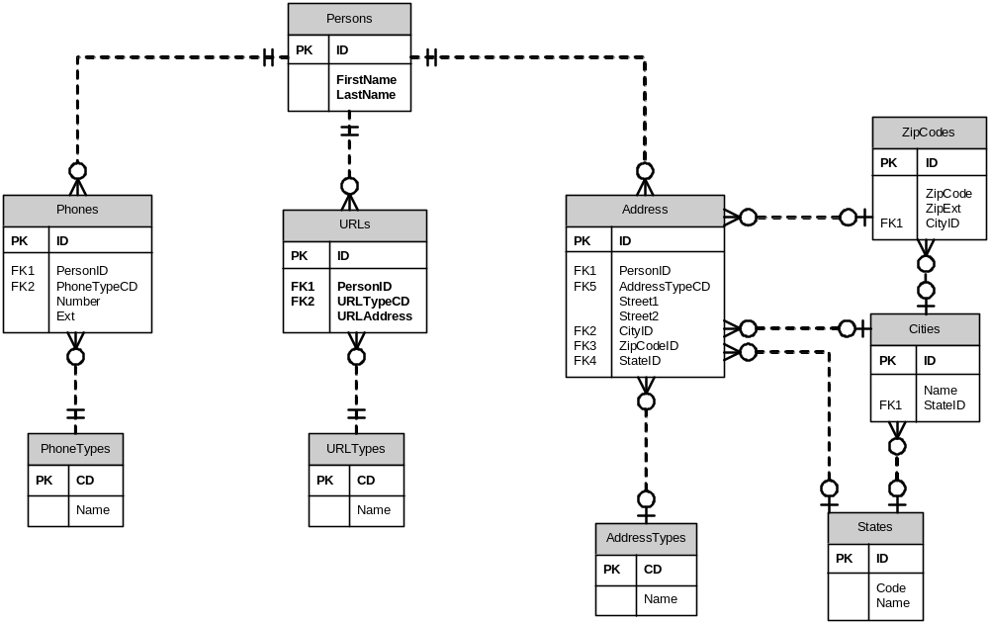
Link Person to Contact information

Slide 35
Migrate from 3NF to 4NF
A relation is in 4NF if it has no multi-valued dependencies.

Slide 36
#1: No Muti-Value Dependencies
None
Found

Slide 37
Thank You

